Slide 1
DoorDash Product Pitch
Food delivery using Self-Driving Robots
Ayileye DAYO

Slide 2
Background
Why Are We Here?
Ever wondered how to make small deliveries more efficient and profitable?
Can we reduce carbon footprint and make deliveries close to environmental best possible standard?
Is there a way to reduce the required human effort in short, small deliveries?
Can we reduce both operating cost and the resultant consumer charger on small distance deliveries?
[Robo-Dasher]

Slide 3
Business Case
Notes:
[ALL PARTICIPATION]

Slide 4
Initial Focus
Our Journey so far
At DoorDash , we have been providing services to customers and merchants since 2012 across 5 countries with the aid of our efficient Dashers.
With our last-mile logistics infrastructure we have been able to deliver on both user sides.
We currently hold a 56% market share with revenue generated via delivery fee and commission on every order, advertisment and marketing.
https://www.doordash.com/en-US/about
https://en.Wikipedia.org/wiki/DoorDash

Slide 5
Initial Focus
Concerns
Comparatively higher delivery and commission fees
Operation cost
Increasing competitors for market share
http://www.ameranth.com/pdf/How%20Does%20DoorDash%20Make%20Money,%20Feb%2012,%202019.pdf

Slide 6
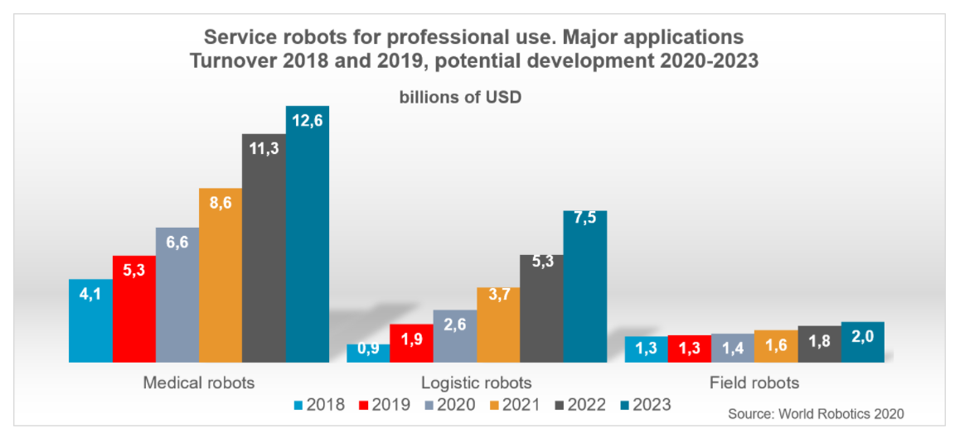
Opportunity
With advancement in autonomous technology and robotics , there has been an increase in the use of automation and service robots in customer based sectors like health care, home maintenance, delivery etc.
© 2019 Udacity. All rights reserved.
One out of three professional service robots sold in 2020 was built for the transportation of goods or cargo
Service robot market has a projected CAGR > 21% over till 2027.
Advent and deployment of Lidar technology
https://ifr.org/service-robots https://ifr.org/img/worldrobotics/Executive_Summary_WR_Service_Robots_2021.pdf
https://www.astuteanalytica.com/industry-report/service-robots-market

Slide 7
Proposal
What’s Our Solution?
Deployment of Autonoums Robots (Robo-Dashers) to handle small deliveries within a 2 mile radius.
Human Dashers handle larger orders and long distance delivery.
Reduced operation cost
Reduced delievry fee charge on customer
Reduced Carbon Footprint

Slide 8
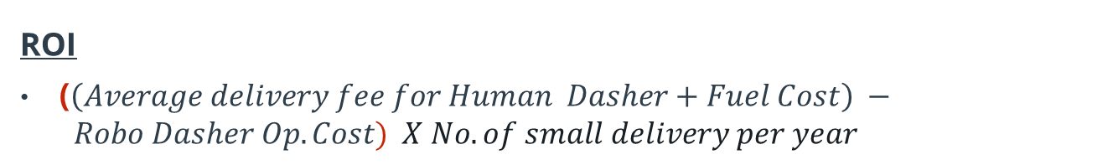
Return On Investment
What can we do?
Deployment and Cost
Identify partner companies and order custom built robots to handle delivery
In-house development of software requirement for Robo-Dasher deployment.
In house hardware maintenance, tracking and human intervention supports.
ROI
($\left(Average delivery fee for Human Dasher+Fuel Cost\right) − Robo Dasher Op. Cost) X No. of small delivery per year$

Slide 9
Measurement
How will we know if we’re successful?
Increase in booking orders for small deliveries by 25%
Increase in positive reviews from customers and merchant that place and provide small delivery by 7%
Increase in market share capitalization > 3%
Reduction in Operating cost > 10%
Reduction in delivery carbon footprint by 15-20%

Slide 10
Competitors
© 2019 Udacity. All rights reserved.
Notes:
[ALL PARTICIPATION]

Slide 11
Grubhub
© 2019 Udacity. All rights reserved.
Formely GrubHub seamless and currently owned by Netherland based Just Eat Takeaway.
Founded in 2004 and services just the United States Market.
Currently facing a decline in Net Income
No plans in place to deploy robot technology
Slower delivery and App technology is very limited.
https://en.wikipedia.org/wiki/Grubhub

Slide 12
Postmates
© 2019 Udacity. All rights reserved.
Founded in 2011 , Operates in 2940 U.S cities .
Rolled back on internationalization plans
Focuses on delivery of consumer goods
Currently developing Autonomous delivery rover
https://en.wikipedia.org/wiki/Postmates

Slide 13
Uber Eats
© 2019 Udacity. All rights reserved.
Founded in 2014 , sprouted out of ride Sharing company-Uber.
Global presence.
Currently working on delivery via drones
Drone deployment is currently skeptic – No regulations, safety risks etc.
https://en.wikipedia.org/wiki/Uber_Eats

Slide 14


Competitors Overview
 | UBER EATS | POSTMATES | GRUBHUB
Global presence
Autonomous Tech.
Focus on Food Delivery

Slide 15
Our Advantages
Why are we better?
We hold 56% market share in the food delivery space
Wide and dominant presence in USA, Canada.
Easy to use app with proven food tracking technology.
Timely deliveries.
Significant number of exclusive customers compared to competitors
Proven track record with restaurant franchises.
https://www.doordash.com/en-US/about
https://en.Wikipedia.org/wiki/DoorDash
https://secondmeasure.com/datapoints/food-delivery-services-grubhub-uber-eats-doordash-postmates/

Slide 16
Roadmap and Vision
Notes:
[ALL PARTICIPATION]

Slide 17
Roadmap Pillars
Where do we go from here?
 | Q1 | Q2 | Q3 | Q4
Development of Robots with Partner Company (Hardware) | Design and Build prototype to serve functionality | Camera, Sensors and Mobility | Security, Integration with Software | Field Testing
App Development (Software) | Map updates and location mapping. | Route detection, Computer vision programs Human needed control interface | Customer side software interface with Robot. App update to include Robo-Dash use | Field Testing

Slide 18
Hardware Development
© 2019 Udacity. All rights reserved.
Robot protyping
Development and design and mechanical build.
Integaration of hardwares that would serves as software complements – cameras, wheels
Testing
Robot balance when under weights
Movement on various surfaces
Anti-theft protection and security

Slide 19
Software Development
© 2019 Udacity. All rights reserved.
Updates to map to include sidewalks routing
OpenCV and computer vision
Lidar technology integration
Object detection.
Human interface for Robo-Dasher control
Customer interface for interation during Robo-Dasher delivery.
Software security
Integration with Hardware team
Develop the current app to integrate Robo-Dasher

Slide 20
Where do we go from here?
Widening the scope
Testing in major USA cities
Further development to reduce Human interference in Robo-Dasher delivery
Improve the delivery radius of Robo-Dasher.
Improve delivery speed and load carrying capacity of Robo- Dasher.
Further intelligent conversation by Robo-Dasher

Slide 21
DoorDash
Design Sprint
Product Manager: Ayileye DAYO

Slide 22
Set the stage
Set the stage for the Design Sprint by framing the problem
Notes:
[ALL PARTICIPATION]

Slide 23
Initial PRD
Background
Over the years , there use of robots to aid manufacturing started, the assembly line and further automation advancement has led to the development of service robots to cater for various needs ranging from Domestic – Industrial, Simple task to Complex/specialized ones , Home – Medical surgeries.
Service robots powered with AI, OpenCV, computer vision aided by advancement in deep learning. Service robots have been able to perform logistics, transportation , delivery and haulage , perform human-level intelligent decisions.
This has created an opportunity to improve automation in their process.

Slide 24
Initial PRD
Problem
Small deliveries has always been an economic and operational tussle for Food delivery.
Customers would rather go get the items themselves when they consider the delivery fee they would be charged for the item.
Human Dashers would rather not take the dash order because there is a chance they would not get a fair enough tip for their effort.
Some restaurants would rather decline this small orders when they consider the commission value.
These problems exist for our competitors in the same market and with rapid advancement in autonomous movement and robotics, an opportunity lies where we could solve this issue using Robots as dashers for small deliveries (Robo-Dasher).
This would in-turn translate in lower operating cost in delivering small order, higher amount of small orders would be places, further market share capitalization.

Slide 25
Initial PRD
Goals
Develop mechanical build of Robots capable of delivery with Partner company.
Develop app to:
Allow robot deliver autonomously using sidewalks as travel path
Allow human control of robot in certain case
Allow robot interface with Customers
Allow Humans make Robo-dasher a choice delivery method
Increase the number of small orders

Slide 26
Understand
Create a shared understanding of the space, problem, and goals
© 2019 Udacity. All rights reserved.
Notes:
[ALL PARTICIPATION]

Slide 27
How Might We
How might we make the robots follow routes and deliver at referenced loaction
How might we ensure robots interpret and follow traffic rules
How might we avoid robot-human- pets Collison
How might we make robots deliver food to customers in multi-storey apartments?
How might we ascertain robots delivery to the right customer
How might we create a robot that can handle obstacles?
How might we set a robot to a safe state in case of an issue?
How might we create robots that picks up food from the right restaurant?
How might we estimate delivery charges
How might we reroute the delivery robot
How might we maintain the robot
How might we create a robot that handles different weather conditions?
How might we make robots deliver food IN Event of Robot failure
How might we allow robots also to advertise the restaurant?
How might we confirm robots handling of customers order
How might we communicate to the delivery robot
How might we ensure food safety and robot safety
How might we calculate the operating costs of a delivery using robots?
How might we choose the right robot for any new order?
How might we create a great robot - customer interaction?
How might we address a technical issue with robot during a delivery?

Slide 28
Stickies pack 1
How might we mitigate accidents between robots and pedestrians?
How might we teach robots to avoid obstacles?
How might we confirm that the robot is at the right address?
How might we teach robots to avoid trouble?
How might we keep vermin away from the robots?
How might we make routes more efficient?
How might we teach robots to avoid stacles?
How might we make routes more efficient?
How might we establish preferred routes?
How might we establish preferred routes?
How might we have robots signal distress when something goes wrong?
How might we allow robots to detect real-time traffic patterns?
How might we program robots to address delays in deliveries?
How might we make robots not scary for dogs?
How might we make our robots tamperproof?

Slide 29
Stickies pack 2
How might we share robot progress with consumers?
How might we enable robots to detect missing items in the order during pickup?
How might we address a sudden power outage?
How might we keep robots odor free, even when carrying smelly food?
How might we alert operators of need for robot intervention conveniently?
How might we handle edge case issues that may arise?
How might we deal with accidents that might occur?
How might we allow users to help us with tracking and feedback?
How might we program robots to address customer returns?
How might we determine when to recharge robot batteries?
How might we anticipate mechanical failures?
How might we overcome technical glitches during a delivery?
How might we ensure food gets delivered without incident?
How might we get food to people quickly when the robot fails?
How might we alert consumers if their delivery is delayed?
How might we program robots to address order cancellations?
How might we control robots?
How might we track each robot?
How might we detect when a robot needs help?
How might we monitor robot progress?
How might we build redundancy into our system?

Slide 30
Stickies pack 3
How might we have robots entertain customers at delivery?
How might we give robots a personality?
How might we help robots talk to people?
How might we communicate with humans around the robot?
How might we enable robots to interpret and speak different languages?
How might we use robots to make people excited about our brand?
How might we make interacting with robots more fun?
How might we teach users to interact with humans?
How might we make our robots act like people?
How might we enable “emotion” modes in robots?
How might we prepare robot to handle deliveries to persons with disabilities?
How might we teach robots manners?
How might we teach empathy to robots?

Slide 31
Monitoring & Controls
How might we make the robots follow routes and deliver at referenced loaction
How might we ensure robots interpret and follow traffic rules
How might we make routes more efficient?
How might we create a robot that can handle obstacles?
How might we control robots?
How might we create a robot that can handle obstacles?
How might we ascertain robots delivery to the right customer
How might we choose the right robot for any new order?
How might we ascertain robots delivery to the right customer
How might we program robots to address order cancellations?
How might we create robots that picks up food from the right restaurant?
How might we keep vermin away from the robots?
How might we enable robots to detect missing items in the order during pickup?
How might we avoid robot-human- pets Collison
How might we confirm robots handling of customers order
How might we ensure food safety and robot safety
How might we alert operators of need for robot intervention conveniently?
How might we program robots to address delays in deliveries?
How might we create a robot that handles different weather conditions?
How might we communicate to the delivery robot
How might we confirm that the robot is at the right address?
How might we teach robots to avoid stacles?
How might we track each robot?
Control
Tracking

Slide 32
Monitoring & Controls
How might we make routes more efficient?
How might we deal with accidents that might occur?
How might we allow robots to detect real-time traffic patterns?
How might we reroute the delivery robot
How might we establish preferred routes?
Routing

Slide 33
Trouble Shooting and Recovery
How might we address a sudden power outage?
How might we detect when a robot needs help?
How might we address a technical issue with robot during a delivery?
How might we address a technical issue with robot during a delivery?
How might we make our robots tamperproof?
How might we maintain the robot
How might we have robots signal distress when something goes wrong?
How might we deal with accidents that might occur?
How might we build redundancy into our system?
How might we make robots deliver food IN Event of Robot failure
How might we alert operators of need for robot intervention conveniently?
How might we set a robot to a safe state in case of an issue?
How might we anticipate mechanical failures?
How might we determine when to recharge robot batteries?
Mitigation
Potential Problems

Slide 34
Others
How might we have robots entertain customers at delivery?
How might we create a great robot - customer interaction?
How might we prepare robot to handle deliveries to persons with disabilities?
How might we use robots to make people excited about our brand?
How might we keep vermin away from the robots?
How might we make our robots act like people?
How might we enable robots to interpret and speak different languages?
How might we teach robots manners?
How might we make interacting with robots more fun?
How might we allow robots also to advertise the restaurant?
How might we teach empathy to robots?
How might we give robots a personality?
How might we teach users to interact with humans?
How might we communicate with humans around the robot?
How might we enable “emotion” modes in robots?
Ads and Marketing
Advanced sophistication
Human Interaction

Slide 35
Sprint Focus
Focus | Monitoring and Control
Slide # | slide #11 and 12
I selected this theme because | Customers expectation are timely delivery of their order to the right location, hence it is pertinent that Robo-Dasher should be able to met this expectation. Monitoring of the robot to provide real time location to the operations team and the customer ensures that the Robo-Dasher is following the efficient route, delivering at the right place . Controls are also needed as it is important in any event when Robo-Dasher needs human intervention , proper steps can be taken to ensure that the customers expectations are me

Slide 36
Define
With an understanding of the problem space, create focus and align on specific outcomes for the Design Sprint
Notes:
[ALL PARTICIPATION]

Slide 37
Future Press Review
Robot Delivery by DoorDash Published by: John Cornor , XYX Group
Of late there has been some white mid-size human robots with the DoorDash branding on the sheets of LA, you would have either encountered them on your walk way or at some resturants.
Doordash has introduced a new way of delivery for its loyal patrons with their Robotics Delivery system , the robots called Robo-Dasher, in patnership with EFG Tech, they have created a beautiful and environmentally friendly solution to meet the needs of their customers.
Robo-dasher caters for consumers whose orders are light orders –snacks, light meals drink and are ordering from a resturant within 2 miles of their delivery location, which evidently solves the isssue many DoorDash customers like myseld have when it comes to small delivery in my proximity , if you are anything like I and my colleagues in the past, I would rather go to the resturant myself than pay the charges for delivery and the subsequent tipping of the Dasher who delivers me a doughnut and a drink from a store blocks away.
With the Robo-dasher integration on the new app , once you place an order that falls in this category , you receive a text confirming your order and your robo-dasher’s e-ID, you can track when your order is picked, the location of the robot and upon arrival at your location, you get a subsequent notification of robo-dasher’s arrival and a unique barcode to help unlock the storage of your order.
Robo-dasher is smart and this innovation by Doordash is very much welcome in its bid to reduce carbon footprint and serve the customers better. Go try it today

Slide 38
Success Metrics
 | Goals | Signals | Metrics
Happiness | Easy to order Timely food delivery | Customer feedback and review after delivery How often they use doordash. | User rating on app stores and surveys No. of week order Referral
Engagement | Number of small orders Tracking Robo-Dasher | Increase in the frequency of small orders Time spent tracking order | No. of small orders per week or month App Session length
Adoption | New app download | Sign up and referrals | Increase in referrals More app store download
Retention | Small deliveries Value of money per app deals | More opt-in on app deals for Robo-dasher delivery More small order | No. of small order per week App deals subcription
Task Success | Constant and continued use of the service by Consumers | More small orders Food tracking | User ratings User feedback post delivery

Slide 39
Sketch
Generate tons of ideas, then narrow them down to two in depth solution sketches
Notes:
[ALL PARTICIPATION]

Slide 40
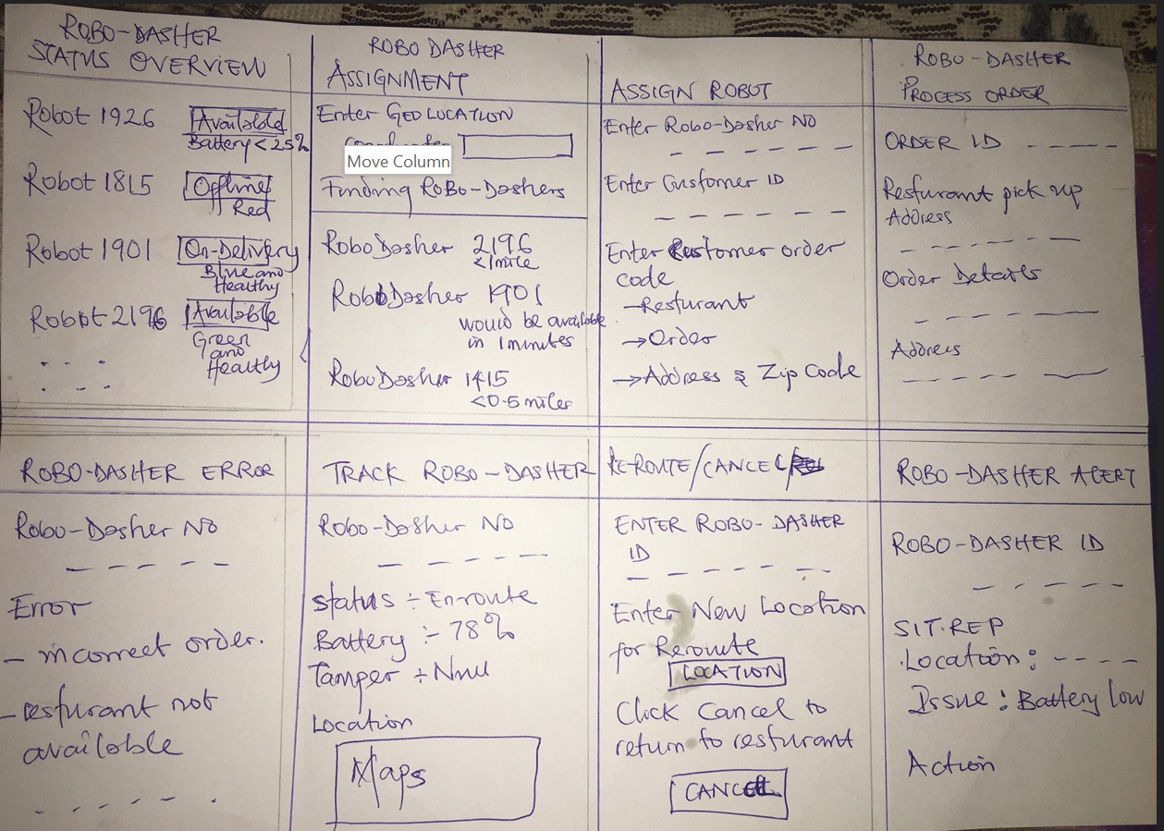
8 Sketches

Slide 41
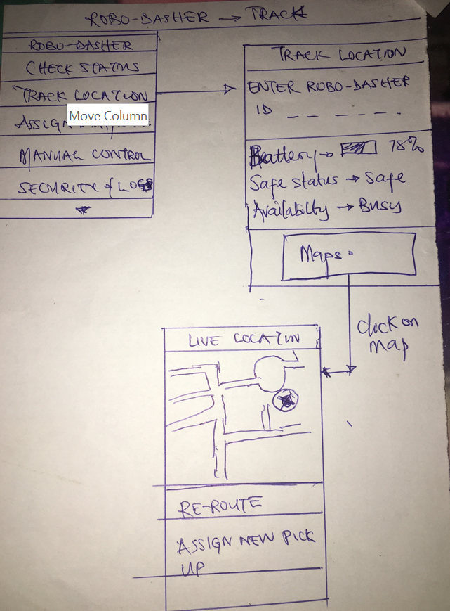
Solution Sketch- Track

Slide 42
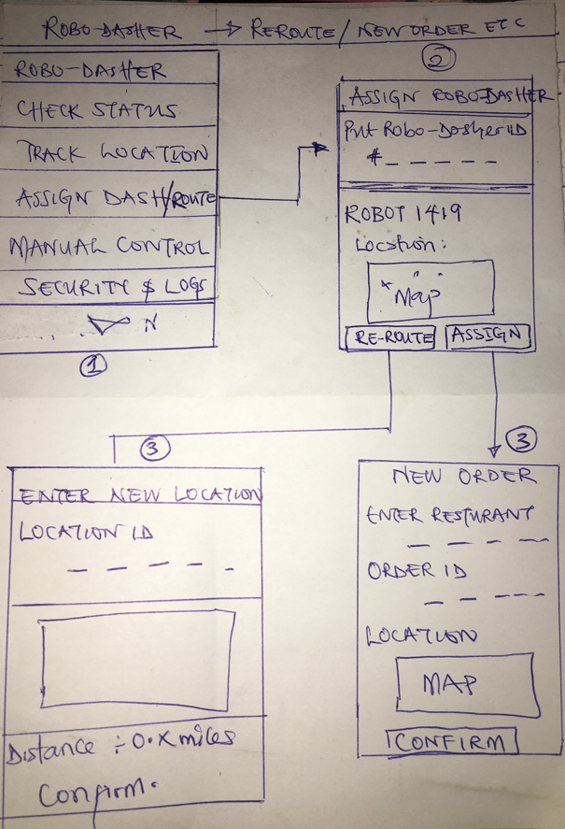
Solution Sketch- Reroute / New Order

Slide 43
Decide
Pick the final concept that you develop into a prototype
Notes:
[ALL PARTICIPATION]

Slide 44
Decision
Decision | TRACK
Rationale | Between the Assign/Route and Track solution sketches. “Assign/route” is meant to assign a new dash to a robo-dasher or re-route a robo dasher. This can be done remotely via backend technologies , however it is pertinent that the Robo-Dasher is firstly located before an assign task or re-route task can be done. Hence the need to focus in TRACK. With track functionality enabled, the robot can be easily located, picked-up in event of malfunction or failure , manual override for human control if necessary , ensure that the dasher is set on proper directions mapping. All this signifiy the criticality and prioirity of the TRACK over ASSIGN.

Slide 45
Prototype
Turn your concept into a realistic, interactive prototype that you will use to validate your assumptions and ideas
Notes:
[ALL PARTICIPATION]

Slide 46
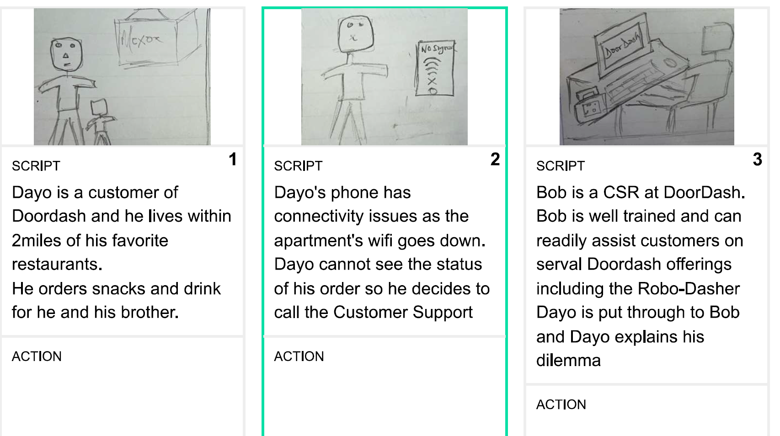
Storyboard

Slide 47
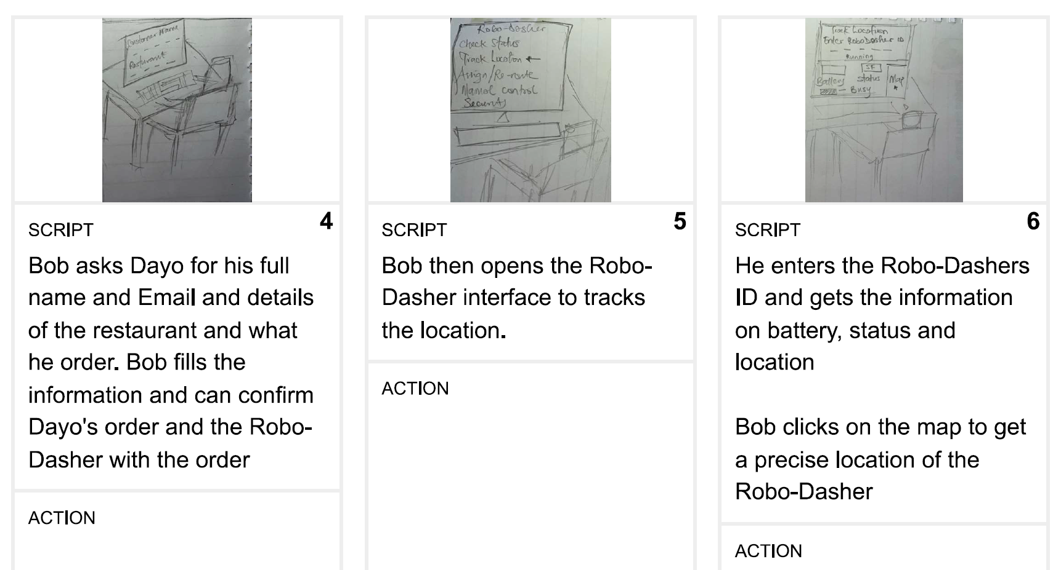
Storyboard

Slide 48
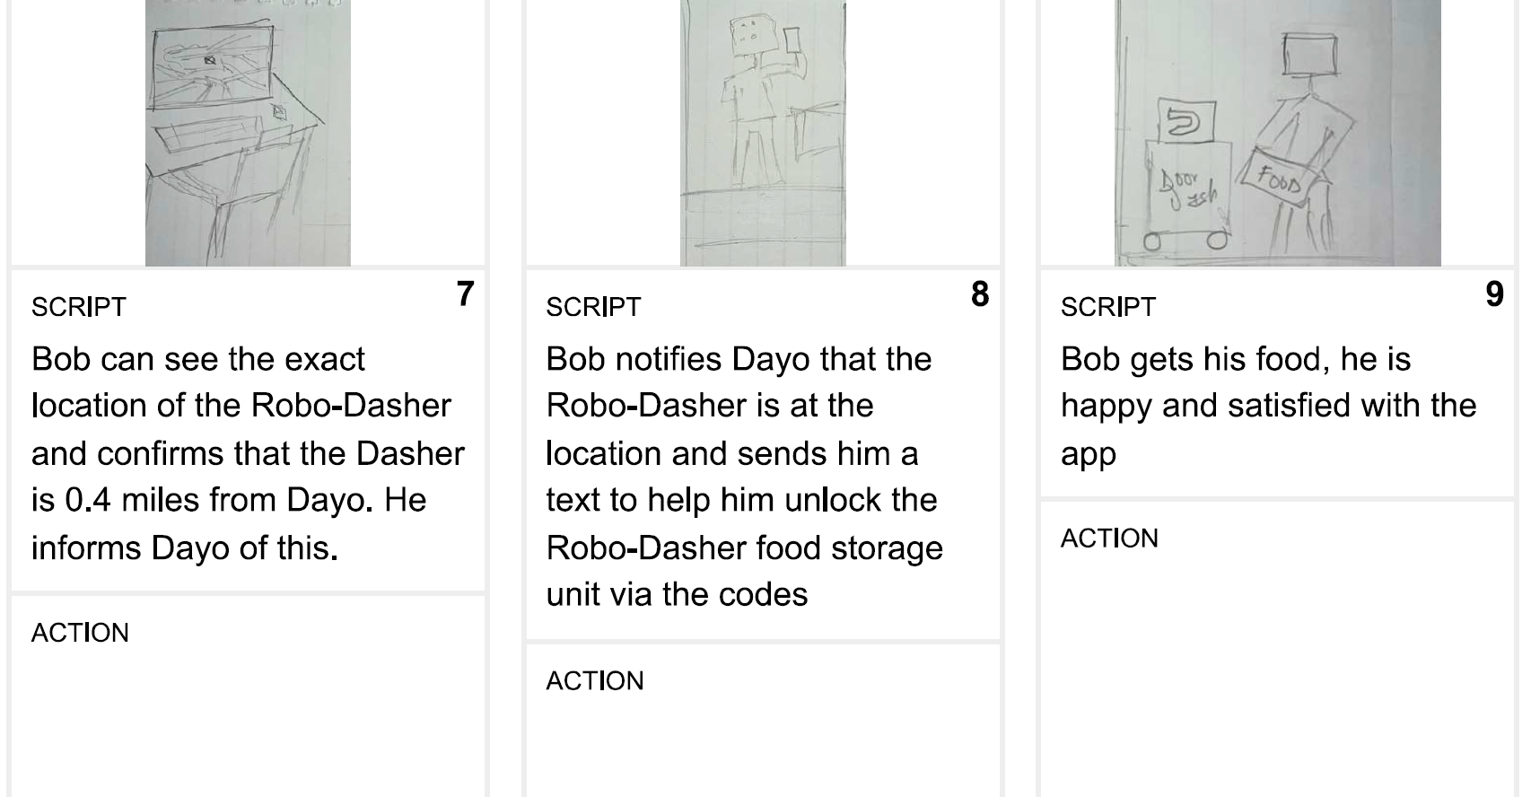
Storyboard

Slide 49
Storyboard
Storyboard file

Slide 50

Prototype – Version 1
Description High level overview of the prototype What does it do? | This prototype gives an overview of the backend functionalities a CSR or support engineer can use to locate, monitor, re-route the Robo-Dasher The prototype focuses on tracking the Robo-dasher to its exact location starting from the CSR login
Assumptions Any assumptions within the prototype | Designed for use by DoorDash back end / support / Operations team Futher functionalities can be developed seperately. Customers can reach CSR team or the deignated team via chat or call from customer app version
Tasks What are the tasks that a user can complete in the prototype? | Determine the status of the Robo-Dasher – battery, security, location , availabilty . Can detrmine robo-dasher ETA and precise location on a map feed Can determine the need for re-route of manual control based on robot location Can confirm Robo-dasher pick up of orders or not Can easily provide Support team with the location of the robot in event of failure
Click the figma and open hyperlink

Slide 51
Validate
Users will go through your prototype and provide feedback on your concept. This is also an opportunity to have an engineering feasibility discussion
Notes:
[ALL PARTICIPATION]

Slide 52
Robo-Dasher Research Plan
Objectives
The key questions that to get answered by these user interviews are as follows:
What does the customer feel about food delivery by robots?
How do they see a feature that gives importance to small food delivery?
What would be some good controls /power that a human operator in the support or operations side can have over robots?
Any improvement / suggestions on the prototype developed
Methodology
Interviews would be conducted in person with the user provided with their own laptop. This would help me to understand their opinion at the first look of the prototype and can judge if this helps them. I could also register their general feeling towards the product and its usability
Participants
Two users from three different fields who uses the food delivery services in their local markets. This would provide an overall idea on different market scenario what the user expects. The first user is a UI/UX, product designer and the second user is a Logistics business personnel

Slide 53
User Testing: Participant 1 Key Findings
What worked well | The user was able to navigate the prototype fairly easily and was able to comprehend the functions of the several buttons and understood the transitioning.
Where participants got stuck | User firstly got stuck trying to figure out where to click on the first page, then once that was sorted , the user wondered how and where to get the Robo-ID from on the page 5 . The user had thought that the app would also be available for the customer.
Other observations | The user was excited at the idea but demanded that the re-route should be developed. The user had other ideas about what the app can do . Asked for functionality on re-routing or cancelling the orders
Text file

Slide 54
User Testing: Participant 2 Key Findings
What worked well | The user had a great understanding of the prototype and the concepts Asked questions based on his opinion and understanding Appreciated the features and the functionality
Where participants got stuck | User firstly got stuck trying to figure out where to click on the first page - Login User had clicked on the Check Robo-Dasher status instead of track Robo-dasher The user wanted to go back and noticed that the close button took him back to the beginning every time he wanted to go back a page.
Other observations | He had a question on why the check robo-dasher staus and Track do not do the dame function , and suggsetd they should be merged into one. He had asked about functionality on re-route and manual overide
Text file

Slide 55
Improvements
Improvement #1 | Login button should be modified
Rationale | The login button is the first step for the CSR/ Ops. Team to have access to monitor the robot. DoorDash prides itself on timely delivery and every seconds counts.
Improvement #2 | Autofill of Robo-Dasher details into screen 5
Rationale | The ID can be numbers, alpha-numeric and trying to write it down or copy it would lead to time wastage , and that is also prone to errors. Once the client order page shows the Robo-dasher ID, a click on track would autofill the ID in the tracker search bar. Saving time and eliminating human errors

Slide 56
Improvements
Improvement #3 | Back Arrow Buttons
Rationale | The CSR/ Ops. Team should be able to move back within pages of the application if needed without having to go to the beginning.
Improvement #2 | Close Buttons
Rationale | The close button should return user to the main menu rather than sign them out , as the amount of time spent manually inputting employee ID and password can be considerable when dealing with a customer

Slide 57

Prototype – Version 2
Click the figma and open hyperlink
Figma pdf
Video

Slide 58
Handoff
© 2019 Udacity. All rights reserved.
Notes:
[ALL PARTICIPATION]

Slide 59
Updated PRD
Updated PRD

Slide 60
DELIVER PRODUCT DOCS
© 2019 Udacity. All rights reserved.
Notes:
[ALL PARTICIPATION]

Slide 61
Launch Email
Marketing Guide
User Guide
Training Guide
PRD

Slide 62
THANK YOU
© 2019 Udacity. All rights reserved.
Notes:
[ALL PARTICIPATION]

